Slide 1
Energy Transition and New Energy Sector
(bài trình bày có sử dụng tài liệu của IDS và KBR)
Ha Noi, 20th November 2023

Slide 2

GLOBAL TRENDS

Slide 3
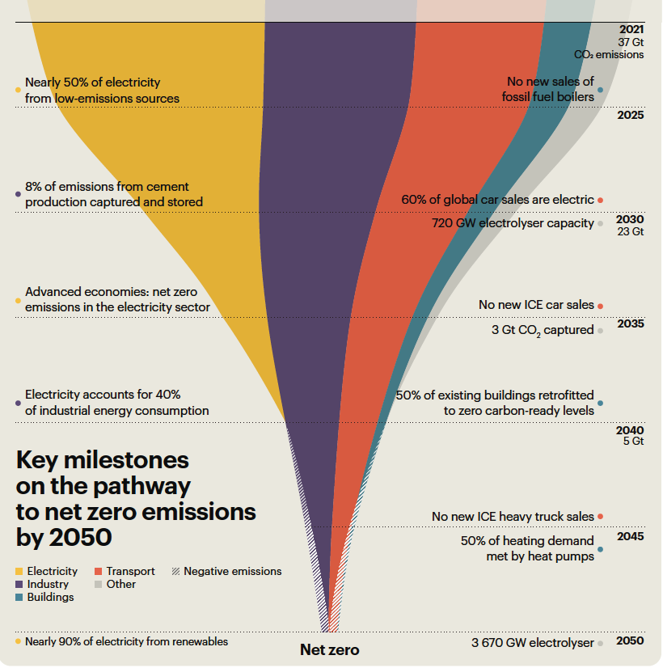
The Journey Towards Net Zero
IDS
Notes:
This slide shows the Base Case.

Slide 4
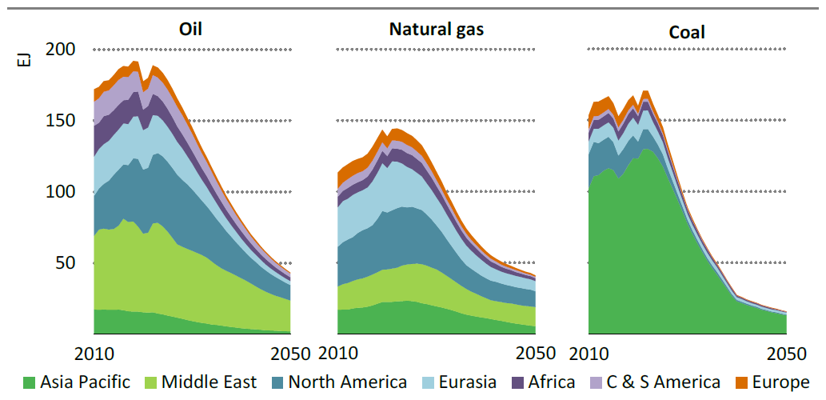
Fuel Supply - Roadmap to Net Zero Emissions by 2050
Oil, natural gas and coal accounted for around four‐fifths of total energy supply worldwide in 2021. In the NZE Scenario, this share falls to around two‐thirds in 2030 and less than one fifth in 2050. Between 2021 and 2050, coal demand declines by 90%, oil declines by around 80%, and natural gas declines by more than 70%.
Oil, natural gas and coal supply by region in the NZE Scenario
Note: C & S America = Central and South America (Source: IEA, 2022).
IDS
Notes:
This slide shows the Base Case.

Slide 5
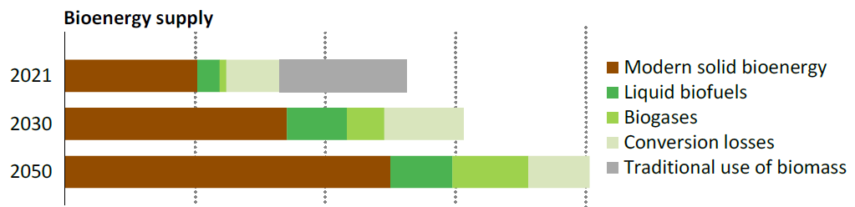
Fuel Supply - Roadmap to Net Zero Emissions by 2050
Net zero emissions does not mean the total phase out of fuels. Fossil fuel use declines, but there is rapid growth in low‐emissions fuels (including solid, liquid and gaseous modern bioenergy, hydrogen and hydrogen‐based fuels. These play a key role in reducing emissions from long‐distance transport and high‐temperature industrial processes.
Bioenergy supply by source in the NZE Scenario, 2021-2050
(Source: IEA, 2022)
For bioenergy, around 24 EJ of current consumption comes from the traditional use of biomass; this drops to zero as full access to modern cooking solutions is achieved by 2030 in the NZE Scenario. Modern bioenergy use increases from around 41 EJ today to more than 75 EJ in 2030 and to 100 EJ in 2050.
IDS
Notes:
This slide shows the Base Case.

Slide 6
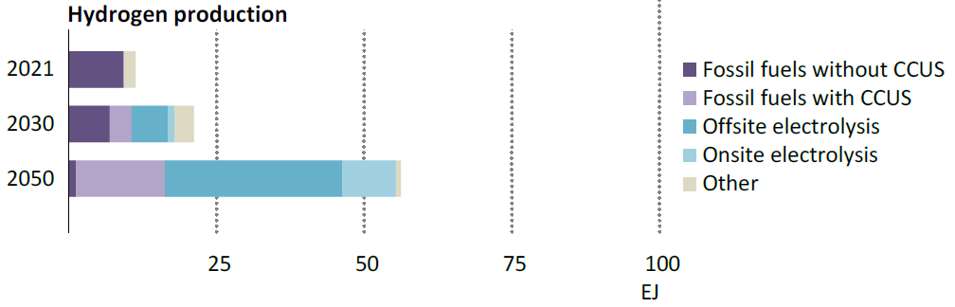
Fuel Supply - Roadmap to Net Zero Emissions by 2050
The supply of low‐emissions hydrogen increases from 0.3 Mt (45 petajoules) today to 90 Mt in 2030 and 450 Mt in 2050. More than 95% of total hydrogen and hydrogen‐based fuel use in 2050 is in transport, power and industry. Of the low‐emissions hydrogen produced in 2050, slightly less than three‐quarters is produced via water electrolysis, and slightly more than one quarter is produced from fossil fuels with CCUS.
Hydrogen production by source in the NZE Scenario, 2021-2050
(Source: IEA 2022)
(Source: IEA, 2022)
The installed capacity of electrolyzers reaches 720 gigawatts (GW) in 2030 and 3,670 GW in 2050 (existing electrolyzer capacity is around 0.51 GW). In 2050, more than 14,800 TWh of electricity is used to produce low emissions hydrogen, equivalent to more than half of today’s global electricity demand from all sources.
IDS
Notes:
This slide shows the Base Case.

Slide 7
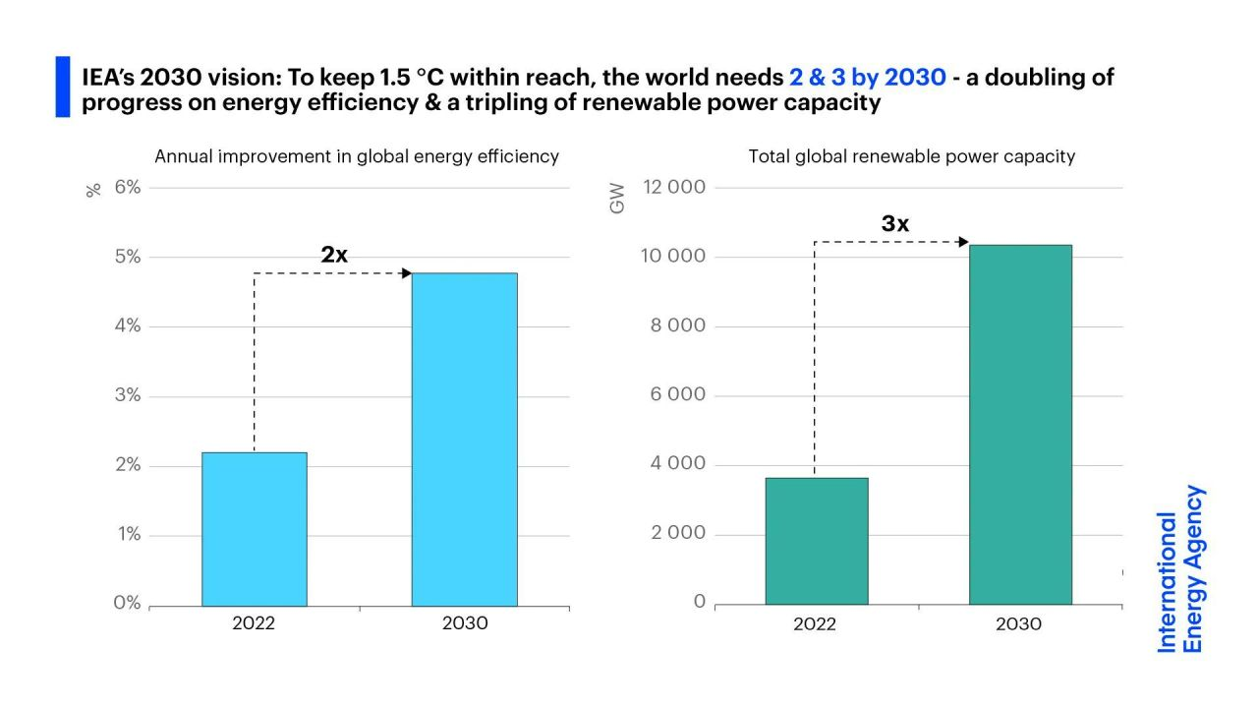
Global Renewable Energy – Huge Potential Future Development
Solar and wind power are the driving forces, annual capacity additions have more than doubled from 2015 to 2022, rising by about 11% per year on average.
Swift expansion of renewable capacity can build on strong recent momentum.
IDS
Notes:
This slide shows the Base Case.

Slide 8
The Journey Towards Net Zero – New Energy
Hydrogen (H₂), mainly used in the refining and chemical sectors, is produced from fossils, accounting for 6% of global natural gas use and 2% of coal consumption, and is responsible for 830 million tonnes of CO₂ emissions annually.
When produced from renewable power, green hydrogen can help decarbonize a range of “hard-to-abate” sectors, including long-haul transport, chemicals, iron, and steel production.
Hydrogen can also support the integration of variable renewables in the electricity system, being one of the few options for storing electricity over days, weeks, or months.
As part of the net-zero emissions 2050 target, hydrogen and hydrogen-based fuels could avoid up to 60 gigatonnes of CO₂ emissions by mid-century, equivalent to 6% of total cumulative emissions reductions.
Green hydrogen or emissions-free hydrogen produced using an electrolyzer powered by renewable energy made up only about 1% of overall hydrogen production as of early 2022, the vast majority is still produced using fossil fuels.
The cost of renewable energy and electrolyzer technology continues to fall. By 2030, the cost of electrolyzers could decrease by 70%, compared with 2022 prices.
(Source: IEA and Deloitte)
KBR CONFIDENTIAL
IDS
Notes:
Greatest challenge to mankind. Trillion of USD to be invested in RE + necessary infrastructure
And electrolysis capacity and production capacity to produce the 10% hydrogen needed…
Dominant routes will be electrolysis and NG with CCUS
The wildcard is nuclear
and new innovative routes to hydrogen

Slide 9


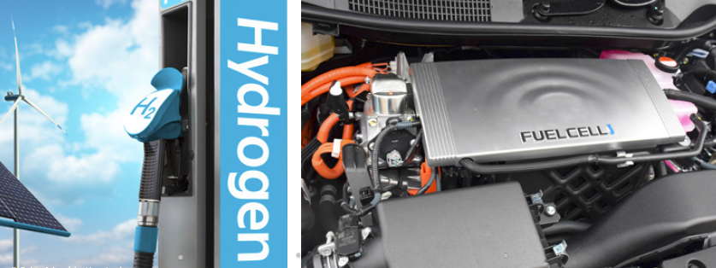
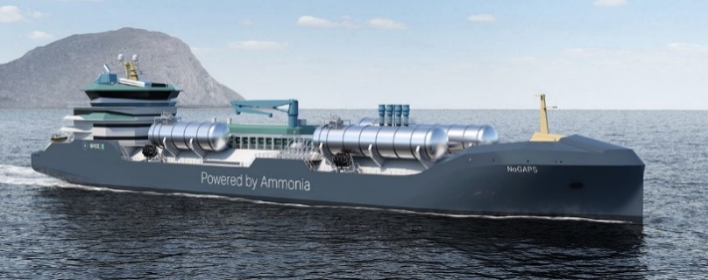
The Journey Towards Net Zero – New Energy
More than 10%
of the world’s energy demand likely to be supplied by hydrogen
Hydrogen is the key molecule
+1,000 hydrogen projects globally
125 GW electrolysis capacity announced by 2030
Ammonia is the key carrier
Existing infrastructure which can be expanded
+100 MTPA to be traded via ships in 2050
KBR CONFIDENTIAL
IDS
Notes:
Greatest challenge to mankind. Trillion of USD to be invested in RE + necessary infrastructure
And electrolysis capacity and production capacity to produce the 10% hydrogen needed…
Dominant routes will be electrolysis and NG with CCUS
The wildcard is nuclear
and new innovative routes to hydrogen

Slide 10
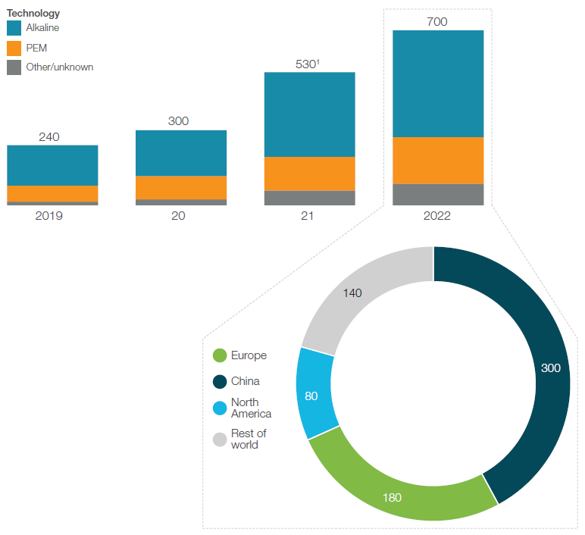
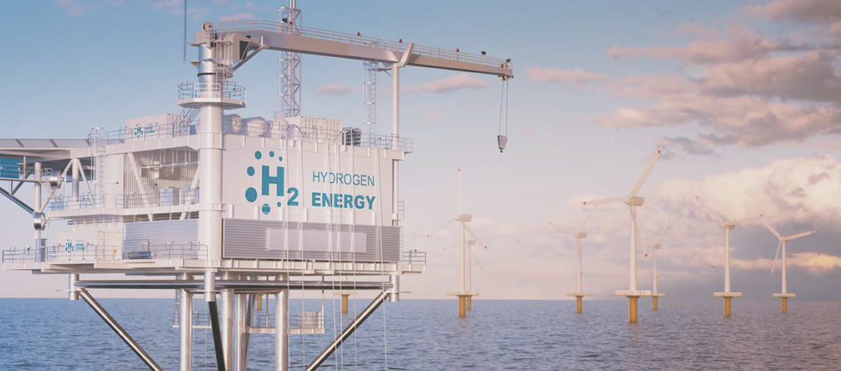
Global Cumulative Installed Electrolysis Capacity, MW
Deployment of electrolysis capacity grew 30% by the end of the year in 2022 versus 2021, reaching 700 MW.
The share of alkaline, Proton Exchange Membrance (PEM), and other electrolyzer technologies has been relatively stable in the past two years, with alkaline electrolysis technology accounting for about 60%, followed by PEM (about 30%) (Source: Hydrogen Council, 2023).
IDS
Notes:
This slide shows the Base Case.

Slide 11
VIETNAM NEW ECONOMIC SECTOR PROSPECT

Slide 12
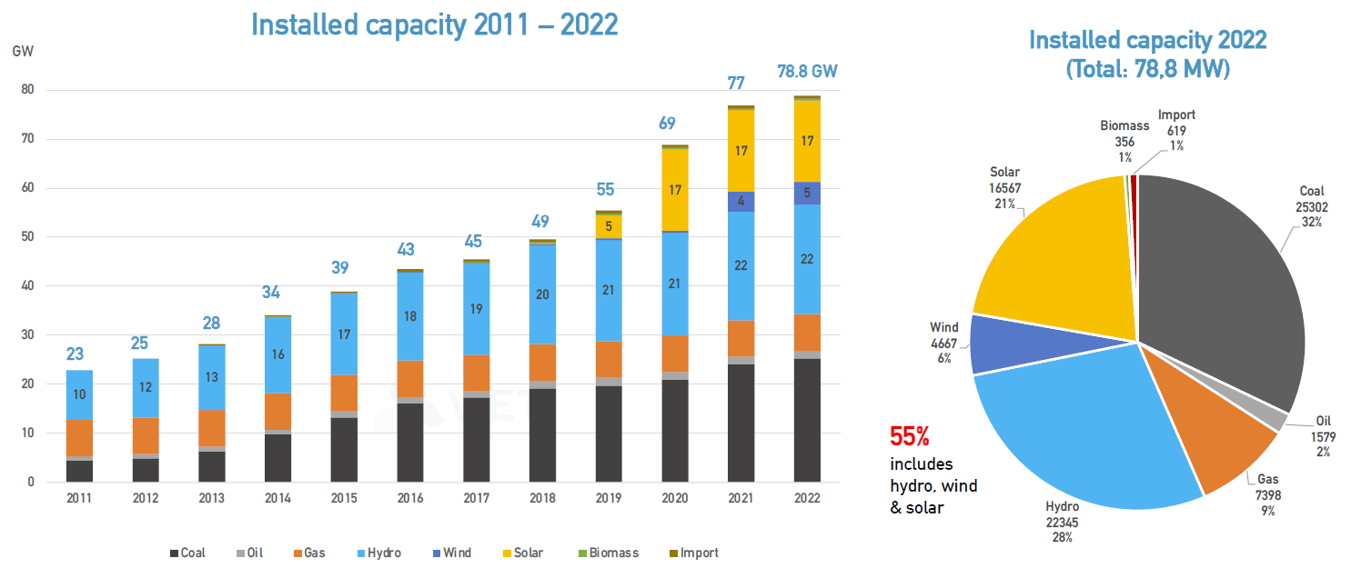
Vietnam Power System Snapshot: Installed Capacity Trend
(Source: EVN, 2023)
IDS
Notes:
This slide shows the Base Case.

Slide 13
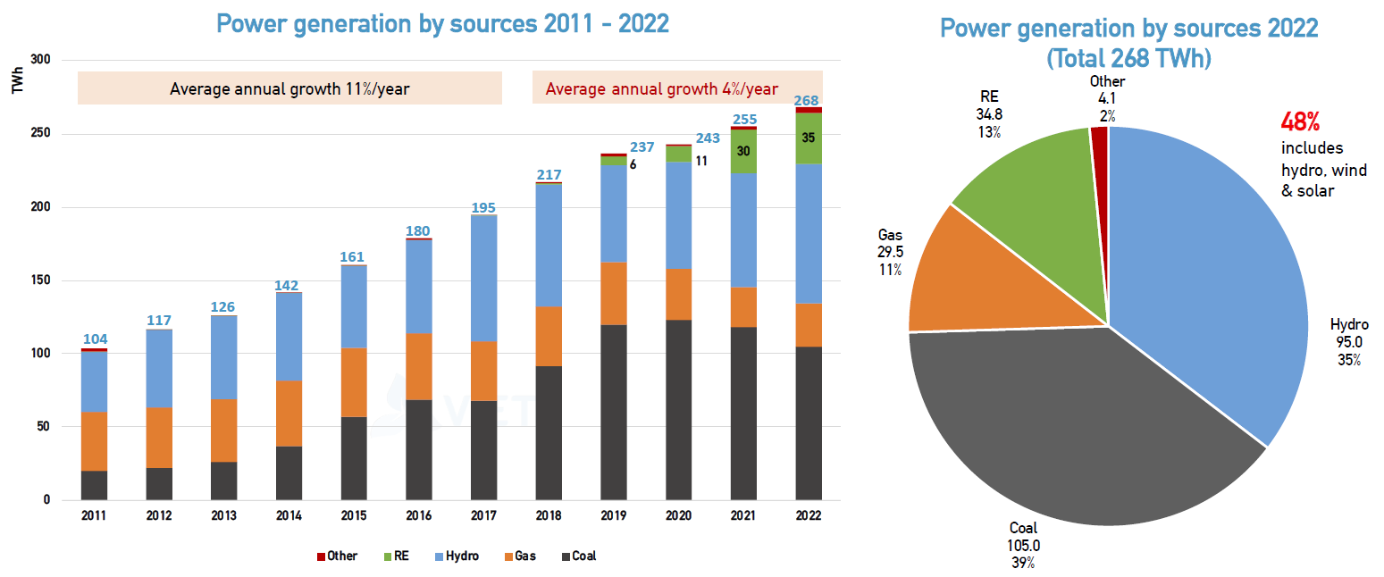
Vietnam Power System Snapshot: Power Generation by Sources
(Source: EVN, 2023)
IDS
Notes:
This slide shows the Base Case.

Slide 14
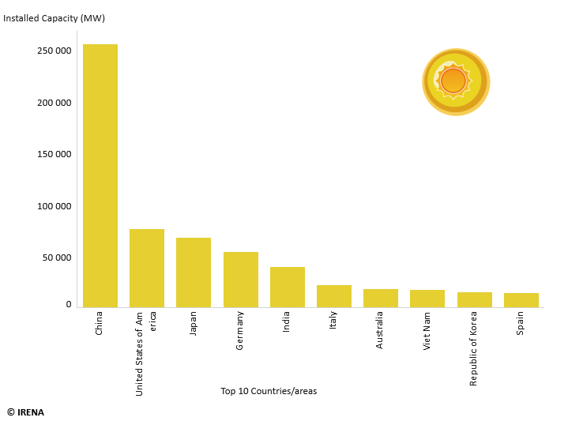
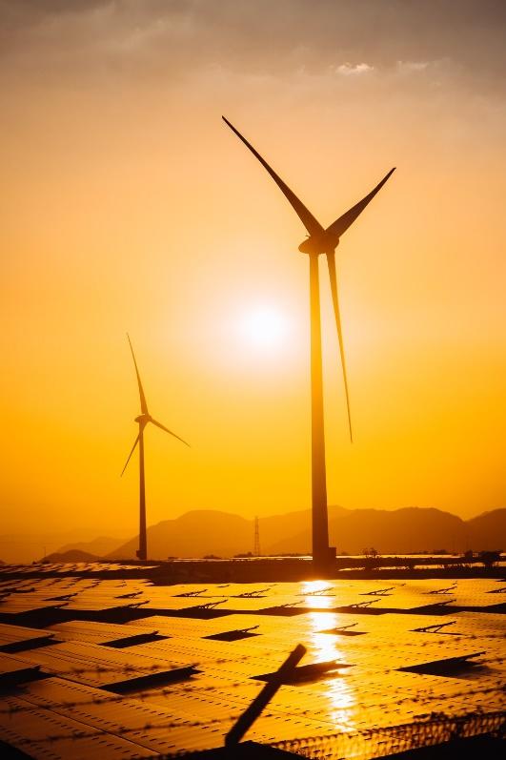
Vietnam - The South East Asia’s Leader in Renewable Energy
(Source: IRENA, 2022)
IDS
Notes:
This slide shows the Base Case.

Slide 15
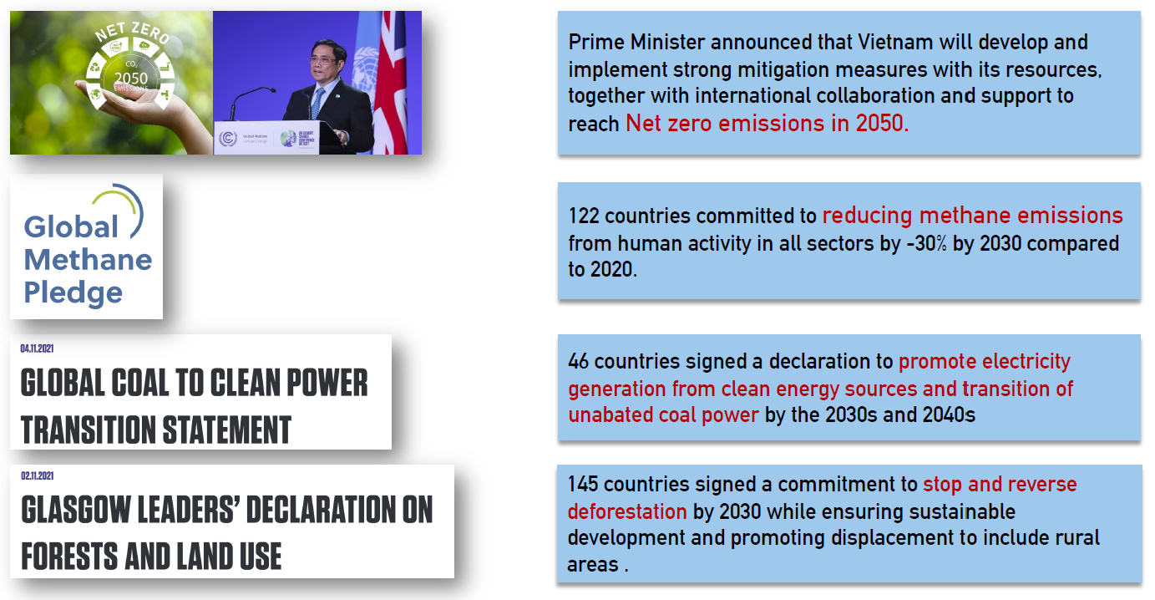
COP26 - Net Zero Commitments and Joint Political Declarations
IDS
Notes:
This slide shows the Base Case.

Slide 16
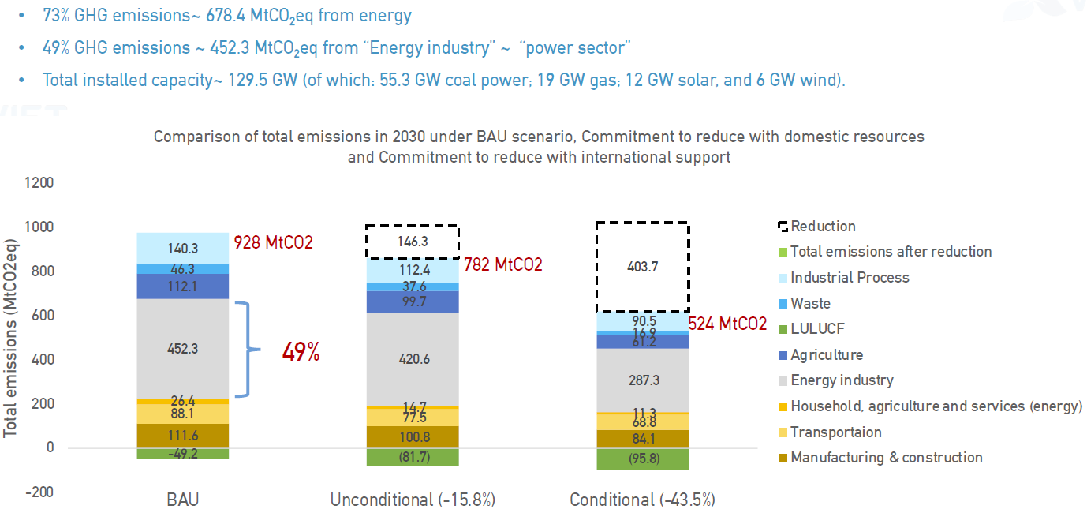
Committed Emission Reductions - 2022
Note: BAU = Business-As-Usual
IDS
Notes:
This slide shows the Base Case.

Slide 17
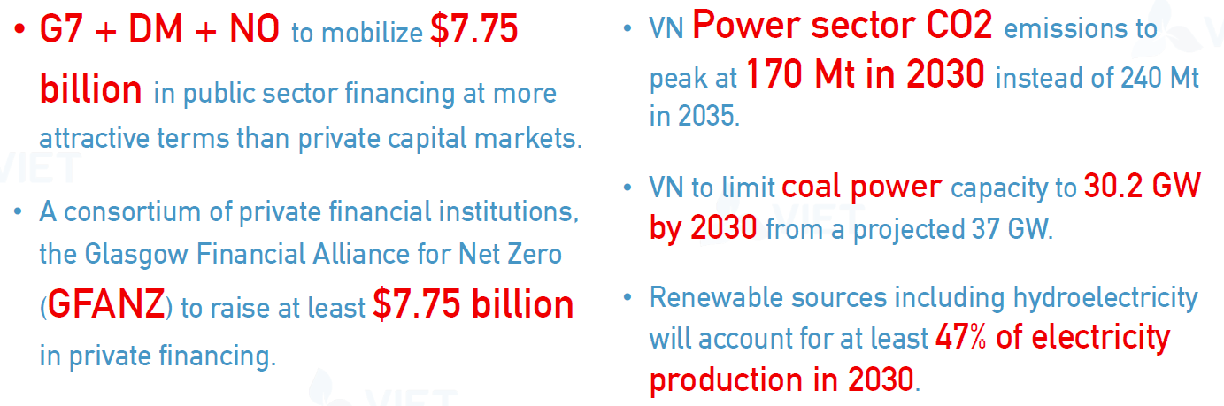
Vietnam - Just Energy Transition Partnership (JETP)
IDS
Notes:
This slide shows the Base Case.

Slide 18
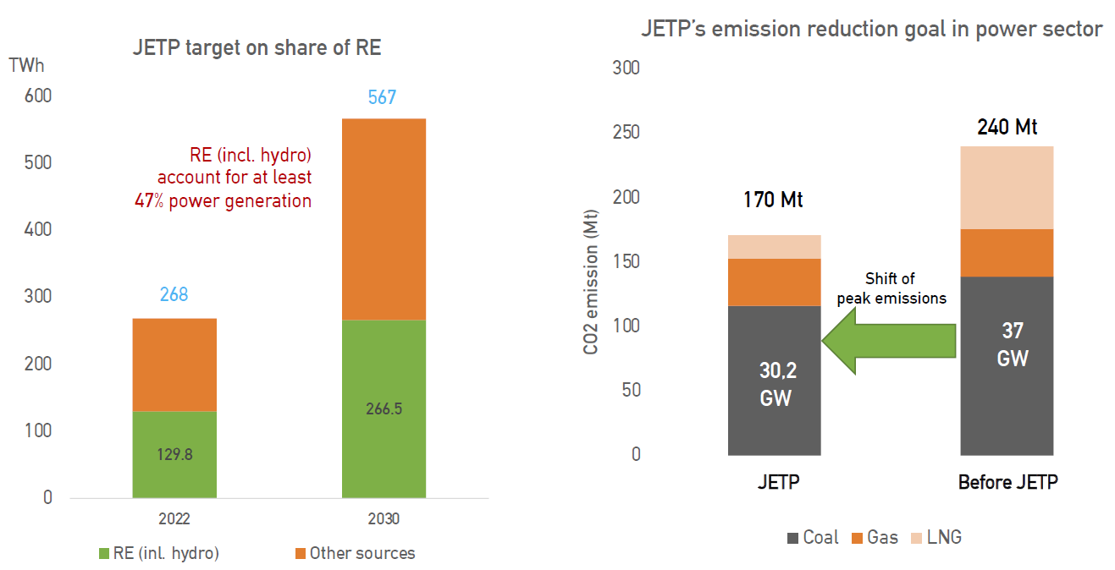
Vietnam - Just Energy Transition Partnership (JETP)
IDS
Notes:
This slide shows the Base Case.

Slide 19
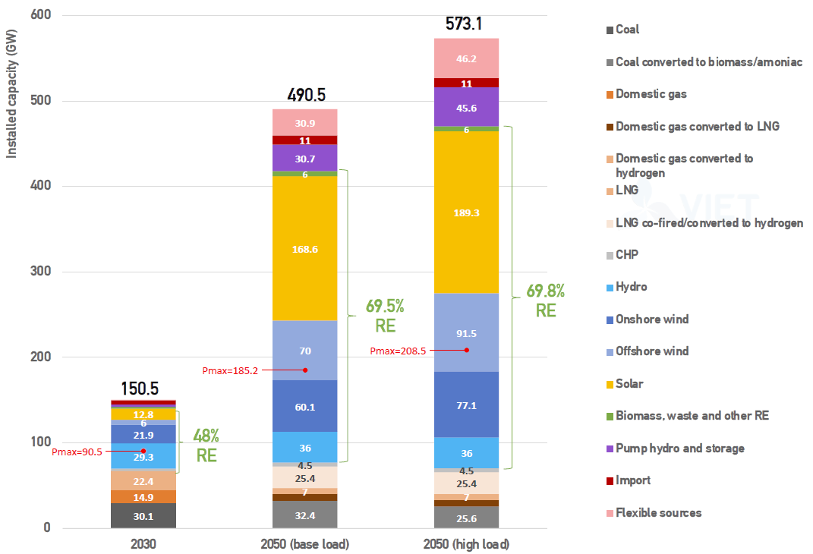
Vietnam Power Development Plan VIII (PDP VIII) - Targets
(Source: Decision No. 500/QD-TTg dated 15/05/2023 of the Prime Minister)
IDS
Notes:
This slide shows the Base Case.

Slide 20
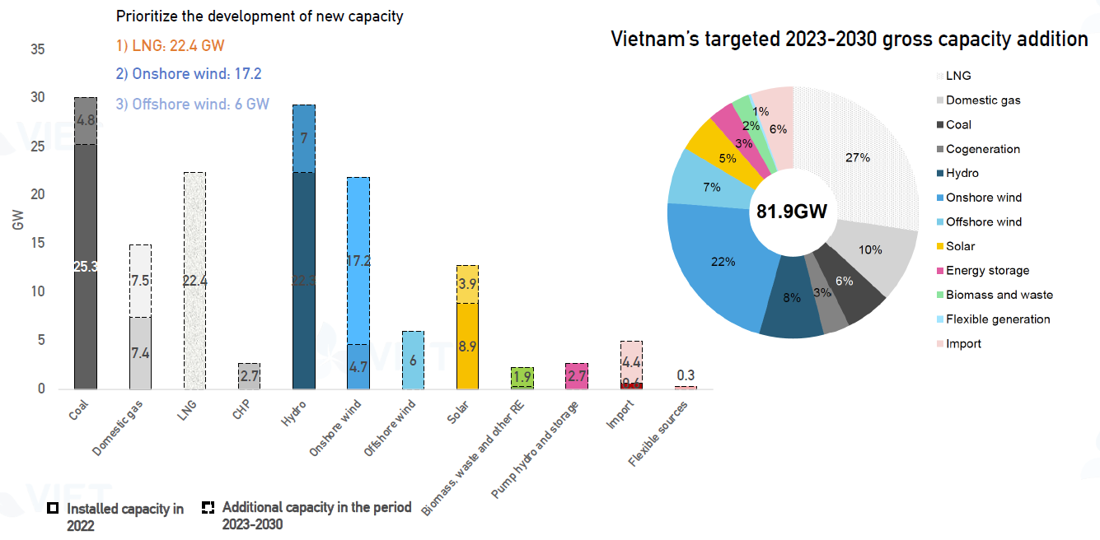
PDP VIII - Development of New Capacity (2023-2030)
(Source: Decision No. 500/QD-TTg dated 15/05/2023 of the Prime Minister)
IDS
Notes:
This slide shows the Base Case.

